Slide 1
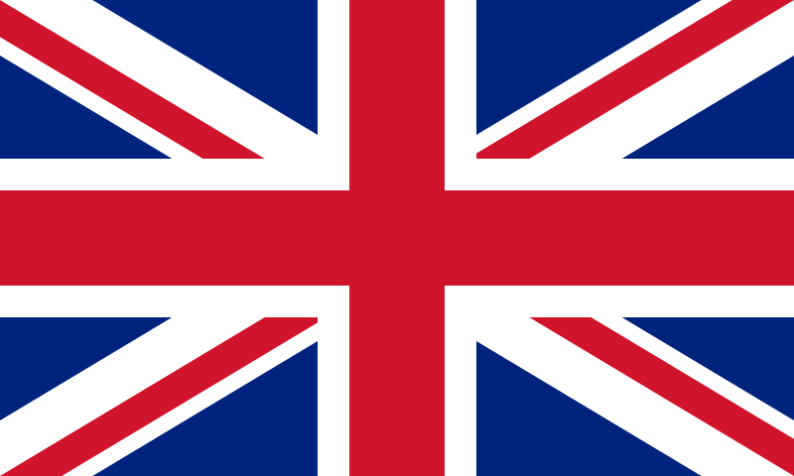
SPOTLIGHT 6
Module 1D
“The United Kingdom”

Slide 2
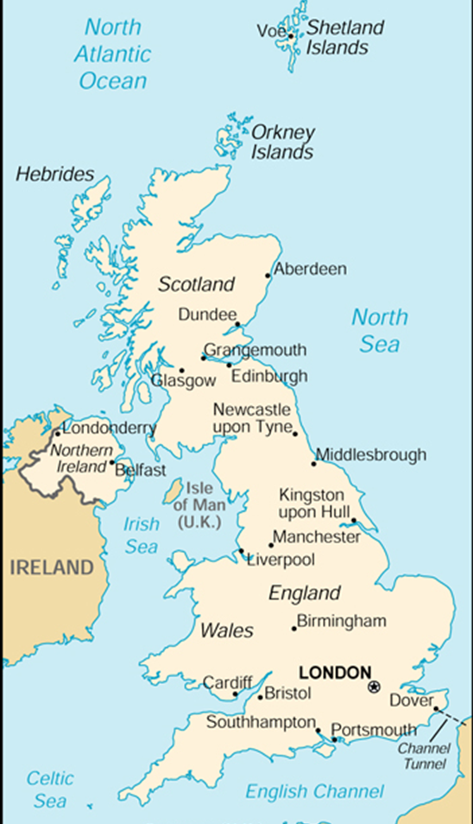
The United Kingdom of Great
Britain and Northern Ireland
The capital of the UK is………..
The UK consists of four parts: England,
Wales,………….. and…………….. .
The capital of England is ………… .
The capital of Scotland is………… .
Edinburgh is the capital of ……….. .
Belfast is ………………………………….. .
The country is washed by the Atlantic
Ocean, …………. and…………. .

Slide 3
The United Kingdom
Part I
The UK is a short name for the United Kingdom of Great Britain and Northern Ireland. It is situated on two large islands, called the British Isles. The larger island is Great Britain, which consists of three parts: England, Scotland, Wales and the smaller is Ireland.
The country is washed by the Atlantic Ocean, the North Sea and the Irish Sea. From the continent it is separated by the English Channel.
The population of the UK is about 60 mln people.
Island-остров
Isle-остров
Consist of- состоять из
Separate-отделять

Slide 4
Do you remember the words?
island
остров
consist of-
отделять
isle
остров
состоять из
is washed by
население
separate
омывается
population

Slide 5
The UK is a short name for the United Kingdom of Great Britain and Northern Ireland. It is situated on two large islands, called the British Isles. The larger island is Great Britain, which consists of three parts: England, Scotland, Wales and the smaller is Ireland.
The country is washed by the Atlantic Ocean, the North Sea and the Irish Sea. From the continent it is separated by the English Channel.
The population of the UK is about 60 mln people.

Slide 6
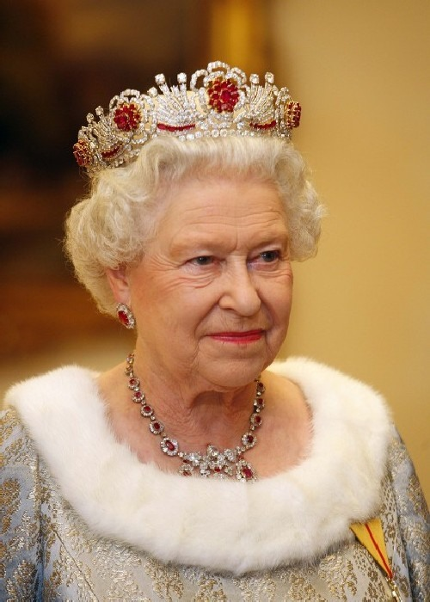
Part II
The longest river in England is the Severn, but the most important one is the Thames.
The UK is the parliamentary monarchy.
The present queen is Elizabeth II. The Queen doesn’t seriously affect the political life of the country.
The capital of the country is London. The important cities are: London, Liverpool and Glasgow.
important важный
monarchy монархия
queen королева
to affect воздействовать

Slide 7
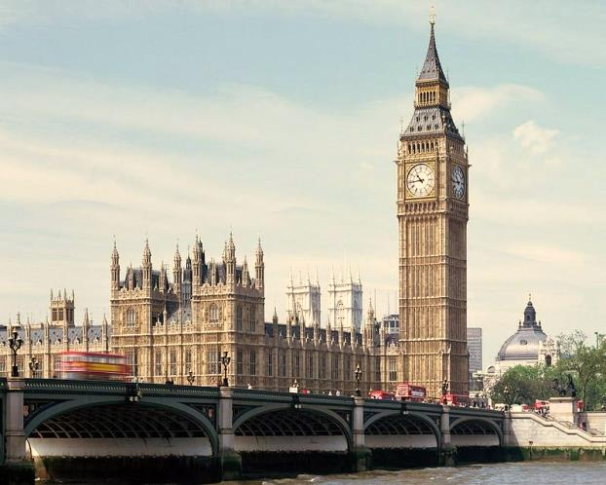
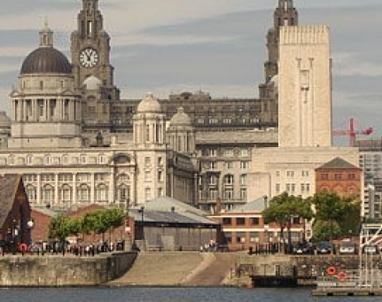
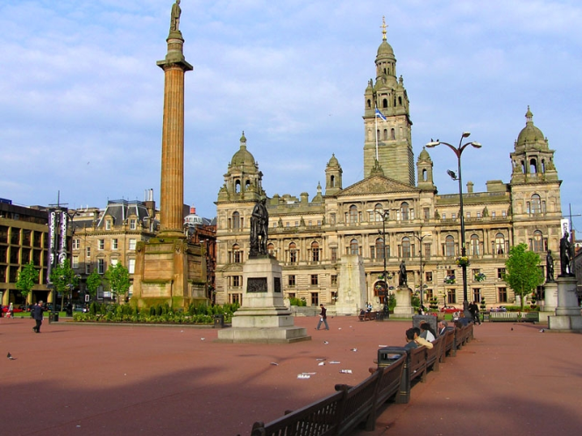
The longest river in England is the Severn, but the most important one is the Thames.
The UK is the parliamentary monarchy.
The present queen is Elizabeth II. The Queen doesn’t seriously affect the political life of the country.
The capital of the country is London. The important cities are: London, Liverpool and Glasgow.
London
Liverpool
Glasgow

Slide 8
Fill in the prepositions:
The UK is situated _____ two islands.
Great Britain consists _____ three parts.
The country is washed _____ the Atlantic Ocean, the North Sea
and the Irish Sea.
4. The longest river ____ England is Severn.
5. The capital ____ the country is London.
Use a, the or zero article where it is necessary:
UK | England
North Sea | Great Britain
London | Atlantic Ocean
Thames | Elizabeth II

Slide 9
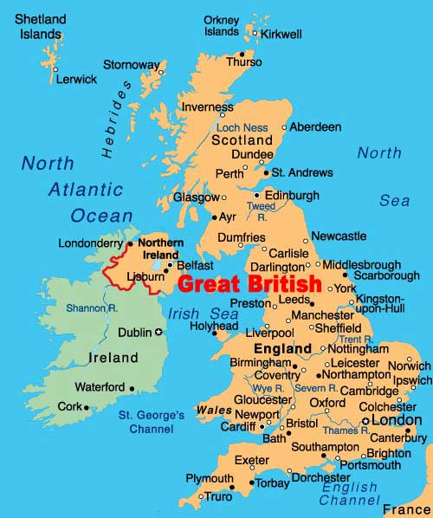
Use the map to talk about the UK

